Slide 1
Software Testing
during
Maintenance
(Chapter 8: Software Testing)
Book: Software Engineering, Ian sommerville, 9th Edition

Slide 2
INTRODUCTION
The process used to identify the correctness, completeness and quality of developed computer software.
It is the process of executing a program/application under positive and negative conditions by manual or automated means.
It checks for the -
  Specification
  Functionality
  Performance

Slide 3
OBJECTIVES
Uncover as many as errors (or bugs) as possible in a given product.
Demonstrate a given software product matching its requirement specifications.
Validate the quality of a software testing using the minimum cost and efforts.
Generate high quality test cases, perform effective tests, and issue correct and helpful problem reports.

Slide 4
Error, Bug, Fault & Failure
Error : It is a human action that produces the incorrect result that produces a fault.
Bug : The presence of error at the time of execution of the software.
Fault : State of software caused by an error.
Failure : Deviation of the software from its expected result. It is an event.

Slide 5
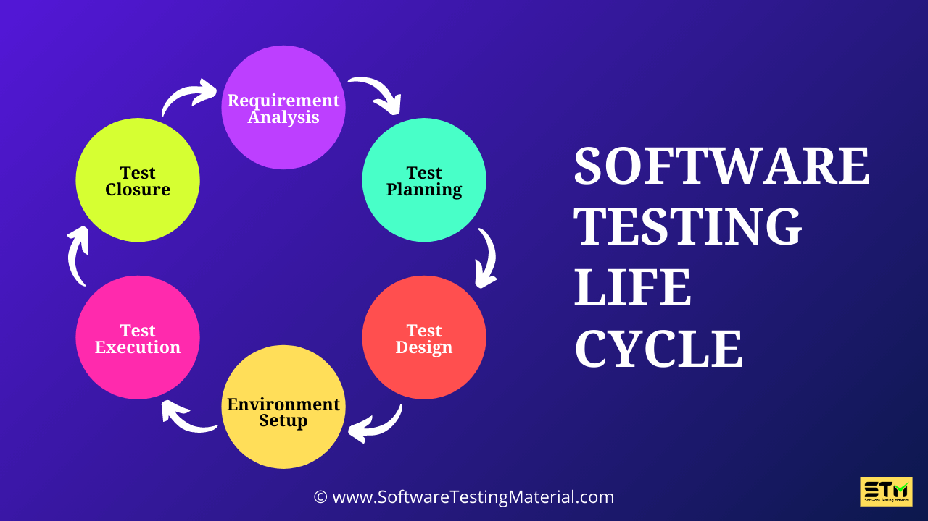
Software Testing Life Cycle

Slide 6
Software Testing Life Cycle
Test Plan: A systematic approach to test a system. The plan typically contains a detailed understanding of what the eventual testing workflow will be.
Test Case: It is a specific procedure of testing a particular requirement. It will include -
Identification of specific requirement tested
Test case success/failure criteria
Specific steps to execute test Test data
Verification vs Validation
Verification: The software should confirm to its specification (Are we building the product right?)
Validation: The software should do what the user really requires (Are we building the right product?)
Testing Methodologies
Black box testing
White box testing

Slide 7
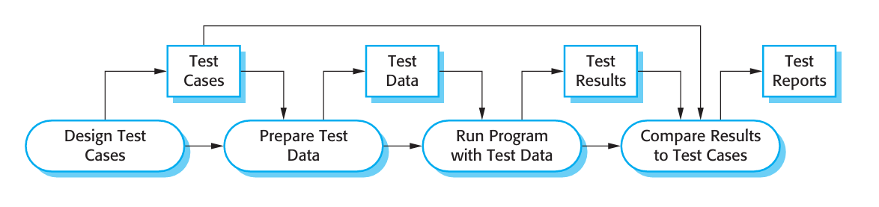
Software Testing Process

Slide 8
Types of Testing
Development testing: where the system is tested during development to discover bugs and defects.
Release testing: where a separate testing team tests a complete version of the system before it is released to users. The aim of release testing is to check that the system meets the requirements of system stakeholders.
User testing: where users or potential users of a system test the system in their own environment. For software products, the ‘user’ may be an internal marketing group who decide if the software can be marketed, released, and sold.

Slide 9
Development Testing
Unit testing: Where individual program units or object classes are tested. Focuses on testing the functionality of objects or methods.
Component testing: Where several individual units are integrated to create composite components. Focuses on testing component interfaces.
System testing: Where some or all of the components in a system are integrated and the system is tested as a whole. Focuses on testing component interactions.
Development testing is primarily a defect testing process, where the aim of testing is to discover bugs in the software. It is therefore usually interleaved with debugging— the process of locating problems with the code and changing the program to fix these problems.

Slide 10
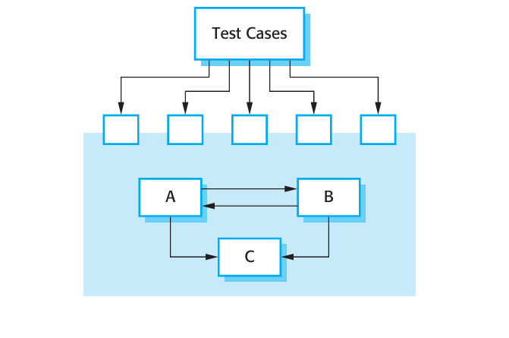
Component Testing
Software components are often composite components that are made up of several interacting objects.
Focuses on showing that the component interface behaves according to its specification.
You can assume that unit tests on the individual objects within the component have been completed.

Slide 11
Types of interface between program components
Parameter interfaces: These are interfaces in which data or sometimes function references are passed from one component to another. Methods in an object have a parameter interface.
Shared memory interfaces: These are interfaces in which a block of memory is shared between components. Data is placed in the memory by one subsystem and retrieved from there by other subsystems. This type of interface is often used in embedded systems, where sensors create data that is retrieved and processed by other system components.
Procedural interfaces: These are interfaces in which one component encapsulates a set of procedures that can be called by other components. Objects and reusable components have this form of interface.
Message passing interfaces: These are interfaces in which one component requests a service from another component by passing a message to it. A return message includes the results of executing the service. Some object-oriented systems have this form of interface, as do client–server systems.

Slide 12
Interface Errors
Interface misuse: A calling component calls some other component and makes an error in the use of its interface. This type of error is common with parameter interfaces, where parameters may be of the wrong type or be passed in the wrong order, or the wrong number of parameters may be passed.
Interface misunderstanding: A calling component misunderstands the specification of the interface of the called component and makes assumptions about its behavior. The called component does not behave as expected which then causes unexpected behavior in the calling component. For example, a binary search method may be called with a parameter that is an unordered array. The search would then fail.
Timing errors: These occur in real-time systems that use a shared memory or a message-passing interface. The producer of data and the consumer of data may operate at different speeds. Unless particular care is taken in the interface design, the consumer can access out-of-date information because the producer of the information has not updated the shared interface information.

Slide 13
Some general guidelines for interface testing
Examine the code to be tested and explicitly list each call to an external component. Design a set of tests in which the values of the parameters to the external components are at the extreme ends of their ranges. These extreme values are most likely to reveal interface inconsistencies.
Where pointers are passed across an interface, always test the interface with null pointer parameters.
Where a component is called through a procedural interface, design tests that deliberately cause the component to fail. Differing failure assumptions are one of the most common specification misunderstandings.
Use stress testing in message passing systems. This means that you should design tests that generate many more messages than are likely to occur in practice. This is an effective way of revealing timing problems.
Where several components interact through shared memory, design tests that vary the order in which these components are activated. These tests may reveal implicit assumptions made by the programmer about the order in which the shared data is produced and consumed

Slide 14
Test-driven development (TDD)
Is an approach to program development in which you interleave testing and code development.
Essentially, you develop the code incrementally, along with a test for that increment. You don’t move on to the next increment until the code that you have developed passes its test.
Test-driven development was introduced as part of agile methods such as Extreme Programming.
However, it can also be used in plan-driven development processes.

Slide 15
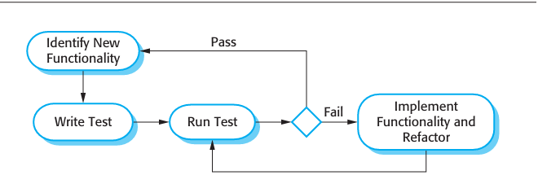
TDD process

Slide 16
Release testing
Is the process of testing a particular release of a system that is intended for use outside of the development team.
Normally, the system release is for customers and users. In a complex project, however, the release could be for other teams that are developing related systems. For software products, the release could be for product management who then prepare it for sale.
There are two important distinctions between release testing and system testing during the development process:
  A separate team that has not been involved in the system development should be responsible for release testing.
  System testing by the development team should focus on discovering bugs in the system (defect testing). The objective of release testing is to check that the system meets its requirements and is good enough for external use (validation testing).

Slide 17
Requirements-based testing
A systematic approach to test case design where you consider each requirement and derive a set of tests for it.
Requirements-based testing is validation rather than defect testing—you are trying to demonstrate that the system has properly implemented its requirements.

Slide 18
Scenario testing
is an approach to release testing where you devise typical scenarios of use and use these to develop test cases for the system.

Slide 19
Performance testing
Performance tests have to be designed to ensure that the system can process its intended load. This usually involves running a series of tests where you increase the load until the system performance becomes unacceptable.
Is concerned both with demonstrating that the system meets its requirements and discovering problems and defects in the system.
To test whether performance requirements are being achieved, you may have to construct an operational profile. An operational profile (see Chapter 15) is a set of tests that reflect the actual mix of work that will be handled by the system. Therefore, if 90% of the transactions in a system are of type A; 5% of type B; and the remainder of types C, D, and E, then you have to design the operational profile so that the vast majority of tests are of type A. Otherwise, you will not get an accurate test of the operational performance of the system.

Slide 20
Types of Performance Test
Stress testing
Load testing

Slide 21
User testing
User or customer testing is a stage in the testing process in which users or customers provide input and advice on system testing. User testing is essential, even when comprehensive system and release testing have been carried out. The reason for this is that influences from the user’s working environment have a major effect on the reliability, performance, usability, and robustness of a system.
In practice, there are three different types of user testing:
Alpha testing: where users of the software work with the development team to test the software at the developer’s site.
Beta testing: where a release of the software is made available to users to allow them to experiment and to raise problems that they discover with the system developers.
Acceptance testing: where customers test a system to decide whether or not it is ready to be accepted from the system developers and deployed in the customer environment

Slide 22
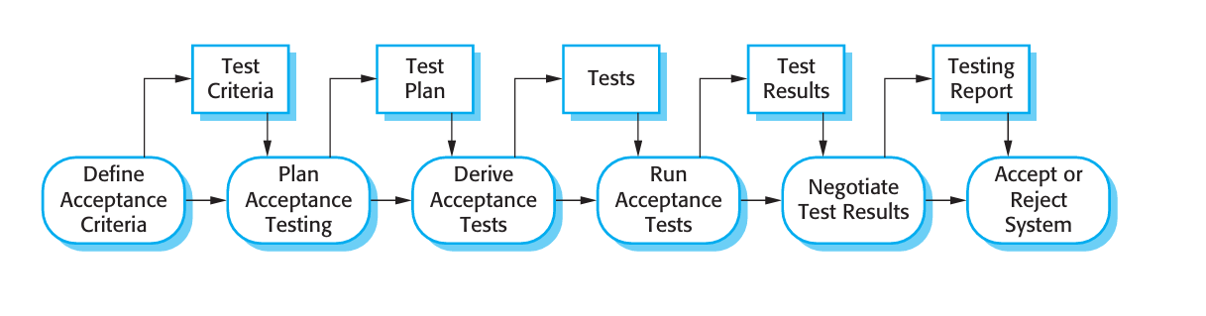
Acceptance testing Process

Slide 23
Acceptance testing process
Define acceptance criteria: The acceptance criteria should be part of the system contract and be agreed between the customer and the developer. In practice, however, it can be difficult to define criteria so early in the process. Detailed requirements may not be available and there may be sig nificant requirements change during the development process.
Plan acceptance testing: This involves deciding on the resources, time, and budget for acceptance testing and establishing a testing schedule. The accep tance test plan should also discuss the required coverage of the requirements and the order in which system features are tested. It should define risks to the testing process, such as system crashes and inadequate performance, and discuss how these risks can be mitigated.
Derive acceptance tests: Once acceptance criteria have been established, tests have to be designed to check whether or not a system is acceptable. Acceptance tests should aim to test both the functional and non-functional characteristics (e.g., performance) of the system.

Slide 24
Acceptance testing process
Run acceptance tests: The agreed acceptance tests are executed on the system. Ideally, this should take place in the actual environment where the system will be used, but this may be disruptive and impractical. Therefore, a user testing environment may have to be set up to run these tests.
Negotiate test results: It is very unlikely that all of the defined acceptance tests will pass and that there will be no problems with the system. If this is the case, then acceptance testing is complete and the system can be handed over. More commonly, some problems will be discovered. In such cases, the developer and the customer have to negotiate to decide if the system is good enough to be put into use.
Reject/accept system: This stage involves a meeting between the developers and the customer to decide on whether or not the system should be accepted.

